Slide 1


Title: Electric Vehicle Market and Performance Analysis

Slide 2

Introduction:
Focuses on Electric Vehicle (EV) Market Analysis using real-world automotive data.
Aims to identify the key factors influencing EV pricing, performance, and efficiency.
Employs Exploratory Data Analysis (EDA) to reveal trends, correlations, and insights.
Data collected through web scraping from trusted EV industry sources.
Analyzes relationships among battery capacity, range, acceleration, and charging speed.
Provides actionable insights for manufacturers, policymakers, and EV consumers.

Slide 3
Business Problem:
The rapid expansion of the EV market has led to vast differences in pricing, range, and performance among brands.
Consumers struggle to identify which specifications provide the best value for money.
Manufacturers lack clear insights into which factors most influence EV market pricing and demand.
A structured data-driven analysis is needed to uncover patterns linking price, performance, and efficiency across EV models.

Slide 4
Objectives
To analyze relationships between EV price, performance, efficiency, and brand characteristics.
To identify key factors that most influence the market value of electric vehicles.
To visualize trends and correlations using Exploratory Data Analysis (EDA) techniques.
To generate actionable insights that support data-driven decisions for manufacturers and consumers.

Slide 5
The Dataset & Target Variable
Source: https://ev-database.org/
Scope: 973 EV models, 15 features.
Key Features:
Performance: Battery Capacity, Real-World Range, Energy Efficiency, Acceleration, Fast Charging.
Design: Vehicle Weight, Towing Capacity, Cargo Volume.
Brand & Market: Brand, Vehicle Status (Available/Discontinued), Availability Years.
🎯 Target Variable: Price (€) - The market price in Euros, serving as the primary indicator of value.

Slide 6
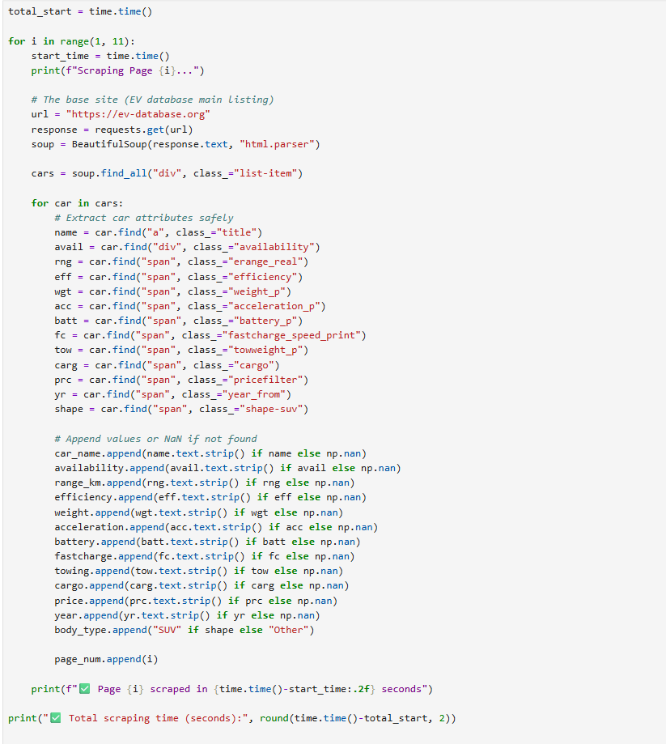
Web Scraping
Extracted Electric Vehicle (EV) data from a reliable automotive database using Python.
Utilized BeautifulSoup and Requests libraries to parse and collect data efficiently.
Captured essential attributes like Brand, Model, Price, Range, Battery Capacity, and Efficiency.
Stored extracted data in a structured CSV format for further cleaning and EDA.
Ensured data accuracy by validating entries and handling missing or inconsistent values.

Slide 7






Tools Used

Slide 8
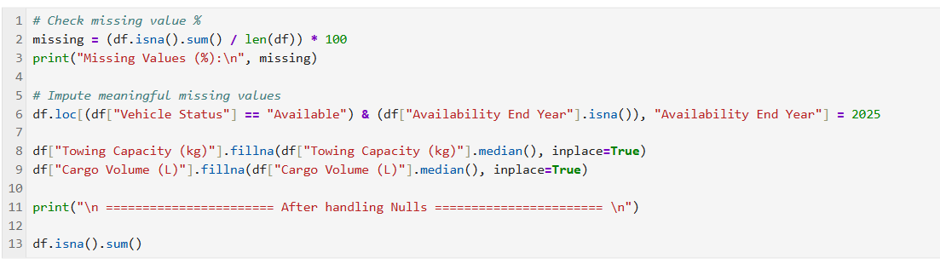
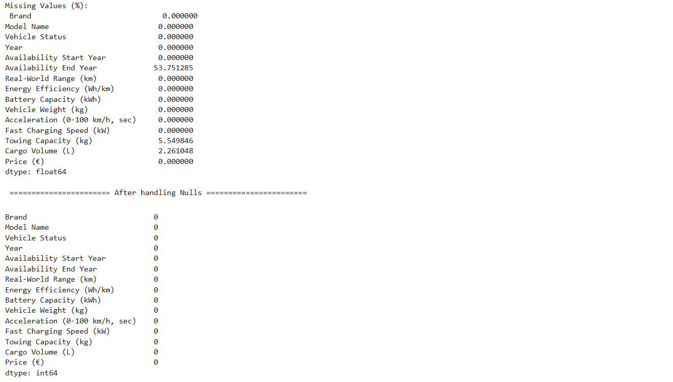
Data Cleaning Steps
Initial State: Dataset had some missing values that required attention.
Handled Missing Values Intelligently:
Availability End Year: For "Available" vehicles, missing values were set to 2025 (current/future year), which is logical.
Towing Capacity (kg) & Cargo Volume (L): Missing values were filled with the median value of their respective columns, a robust statistical method.
Result: A clean, complete dataset with 973 rows and 15 columns, ready for robust analysis.

Slide 9
PART 1: UNIVARIATE ANALYSIS

Slide 10
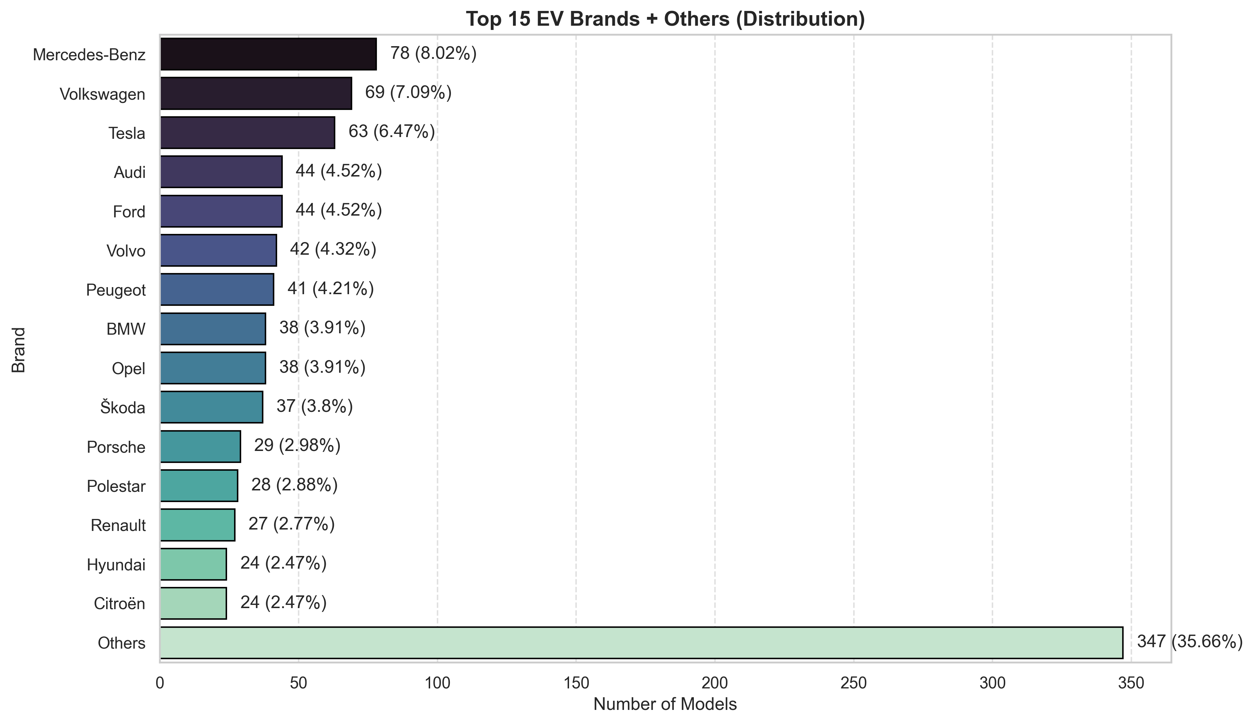
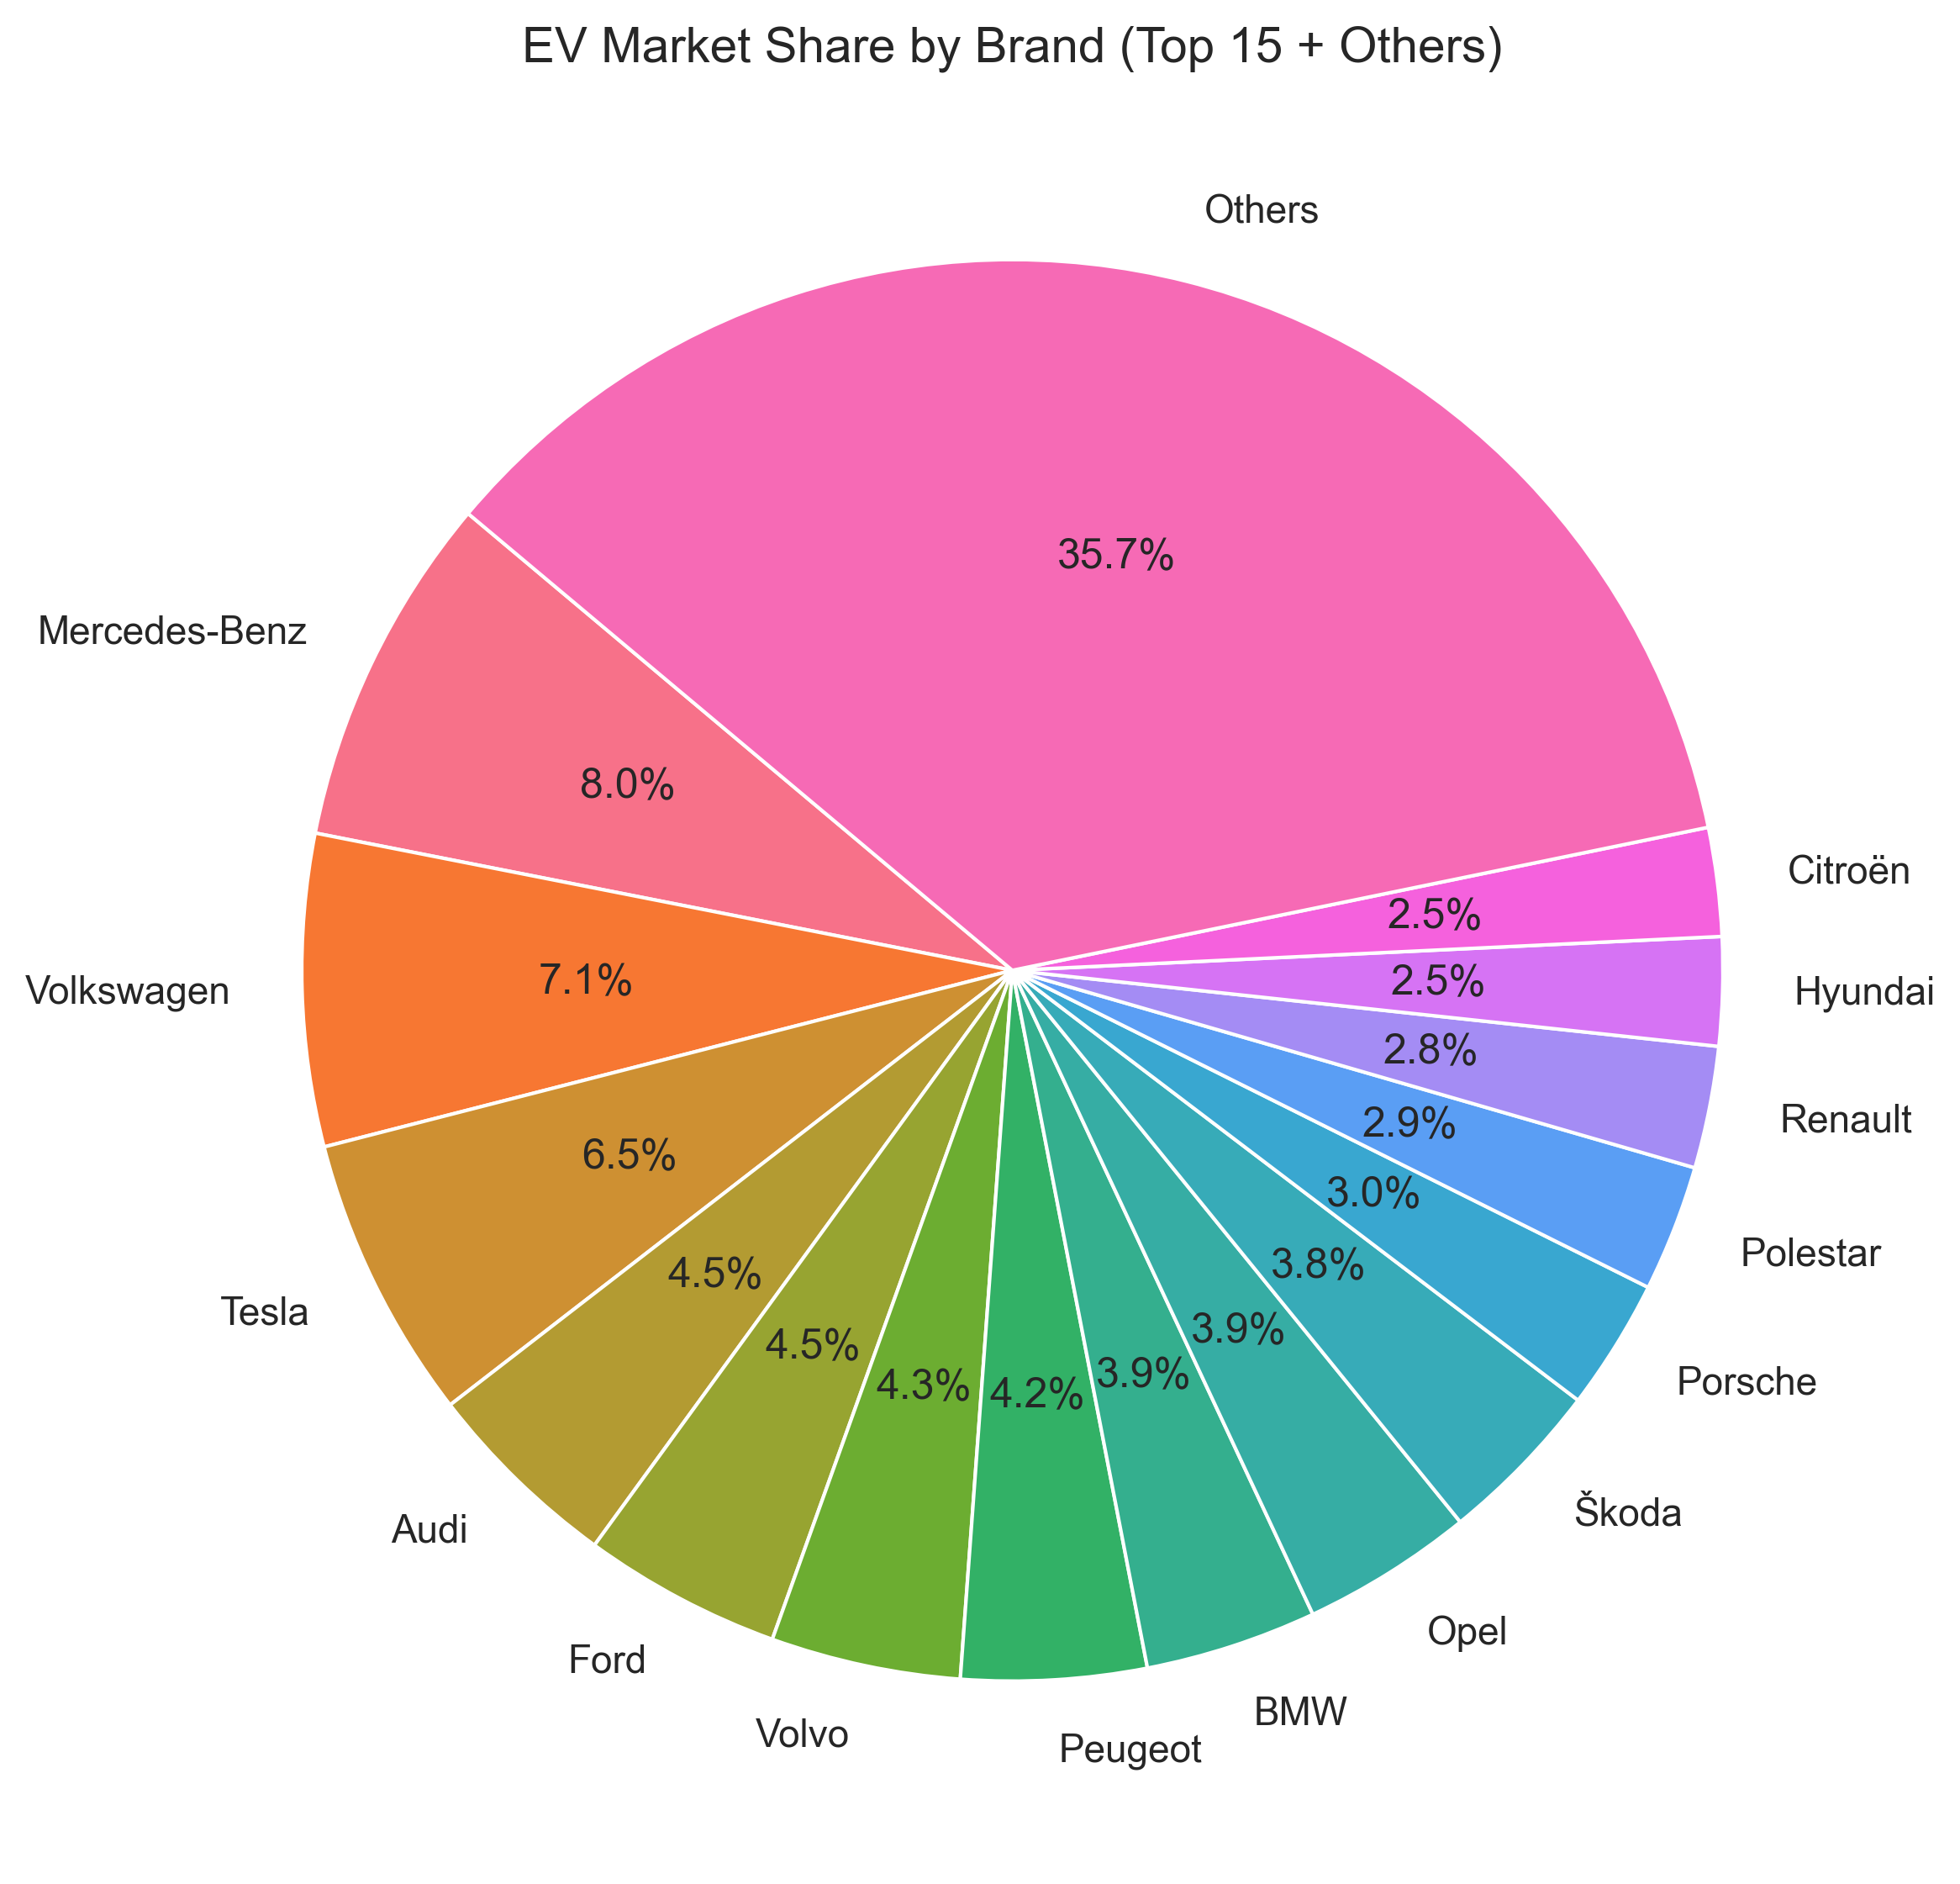
Brand Market Share Analysis
Market Leaders: Mercedes-Benz (8.0%), Volkswagen (7.1%), Tesla (6.5%).
Top 3 Brands control 21.6% of EV market.
Market Concentration: Top 15 brands = 64.3% of models.
Long Tail: "Others" category represents 35.7% from 59 brands.
European Dominance: Strong German automaker presence.
Competitive but concentrated market with established leaders and innovative newcomers.

Slide 11
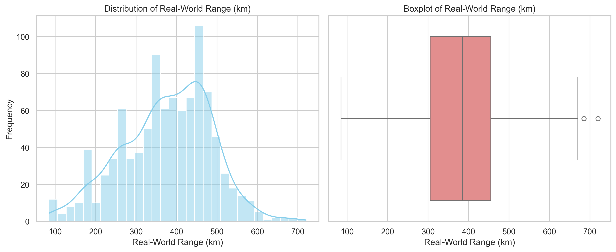
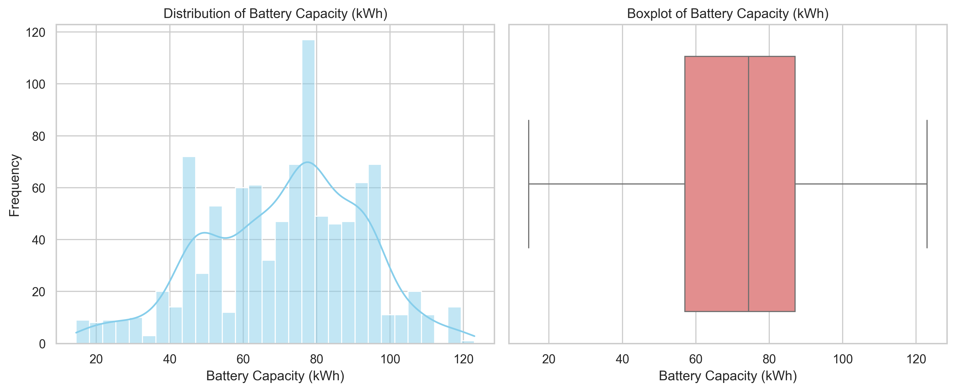
Key Performance Metrics Distribution
Range Distribution: Centered around 375km (300-450km typical).
Battery Capacity: Clustered around 70-80kWh mainstream, 100+kWh premium.
Market Standardization: Most EVs converge around practical performance levels.
Premium Outliers: High-end models push boundaries in both metrics.
Mature market with standardized expectations, premium segments differentiate through extreme performance.

Slide 12
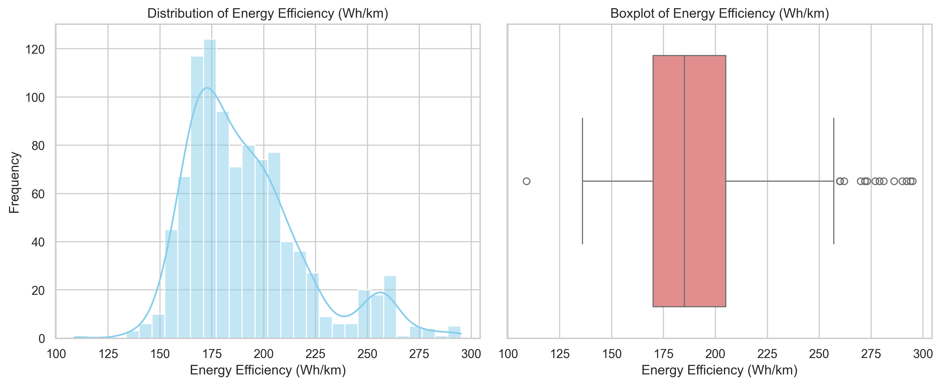
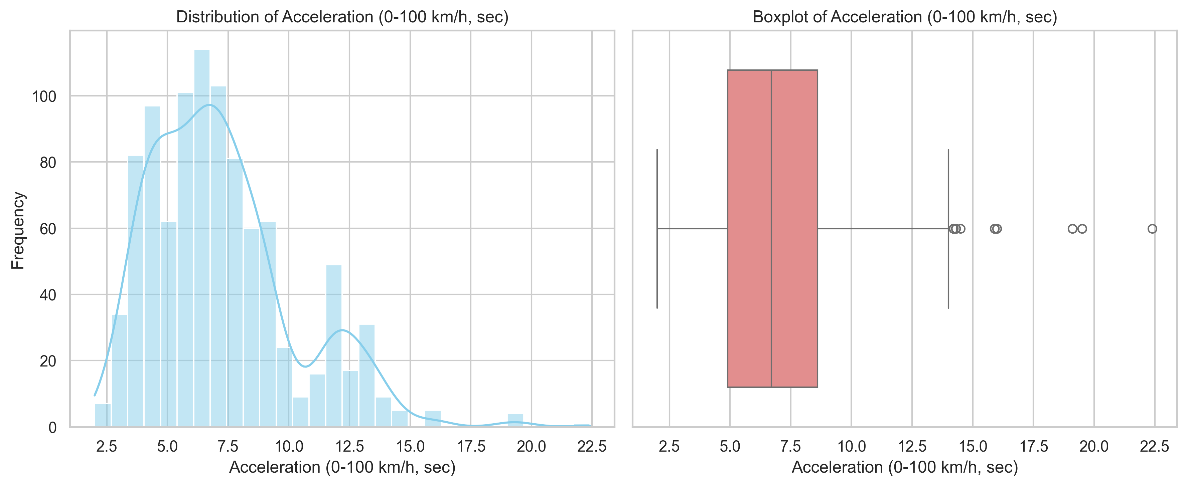
Efficiency & Acceleration Analysis
Energy Efficiency: 170-210 Wh/km optimal range (lower is better).
Acceleration: Most EVs 5-8 seconds, performance models <4 seconds.
Efficiency Focus: Market prioritizes energy optimization
Performance Segment: Clear premium category for acceleration enthusiasts
Efficiency standardization with dedicated performance segment for driving enthusiasts

Slide 13
Charging & Utility Features
Fast Charging: 100-150kW becoming standard, 200+kW premium feature
Towing Capacity: Median 1000kg, 25% of EVs cannot tow
Practical Limitations: Utility features secondary to core performance
Technology Progression: Charging speeds rapidly improving
Core EV technology advancing faster than utility features

Slide 14
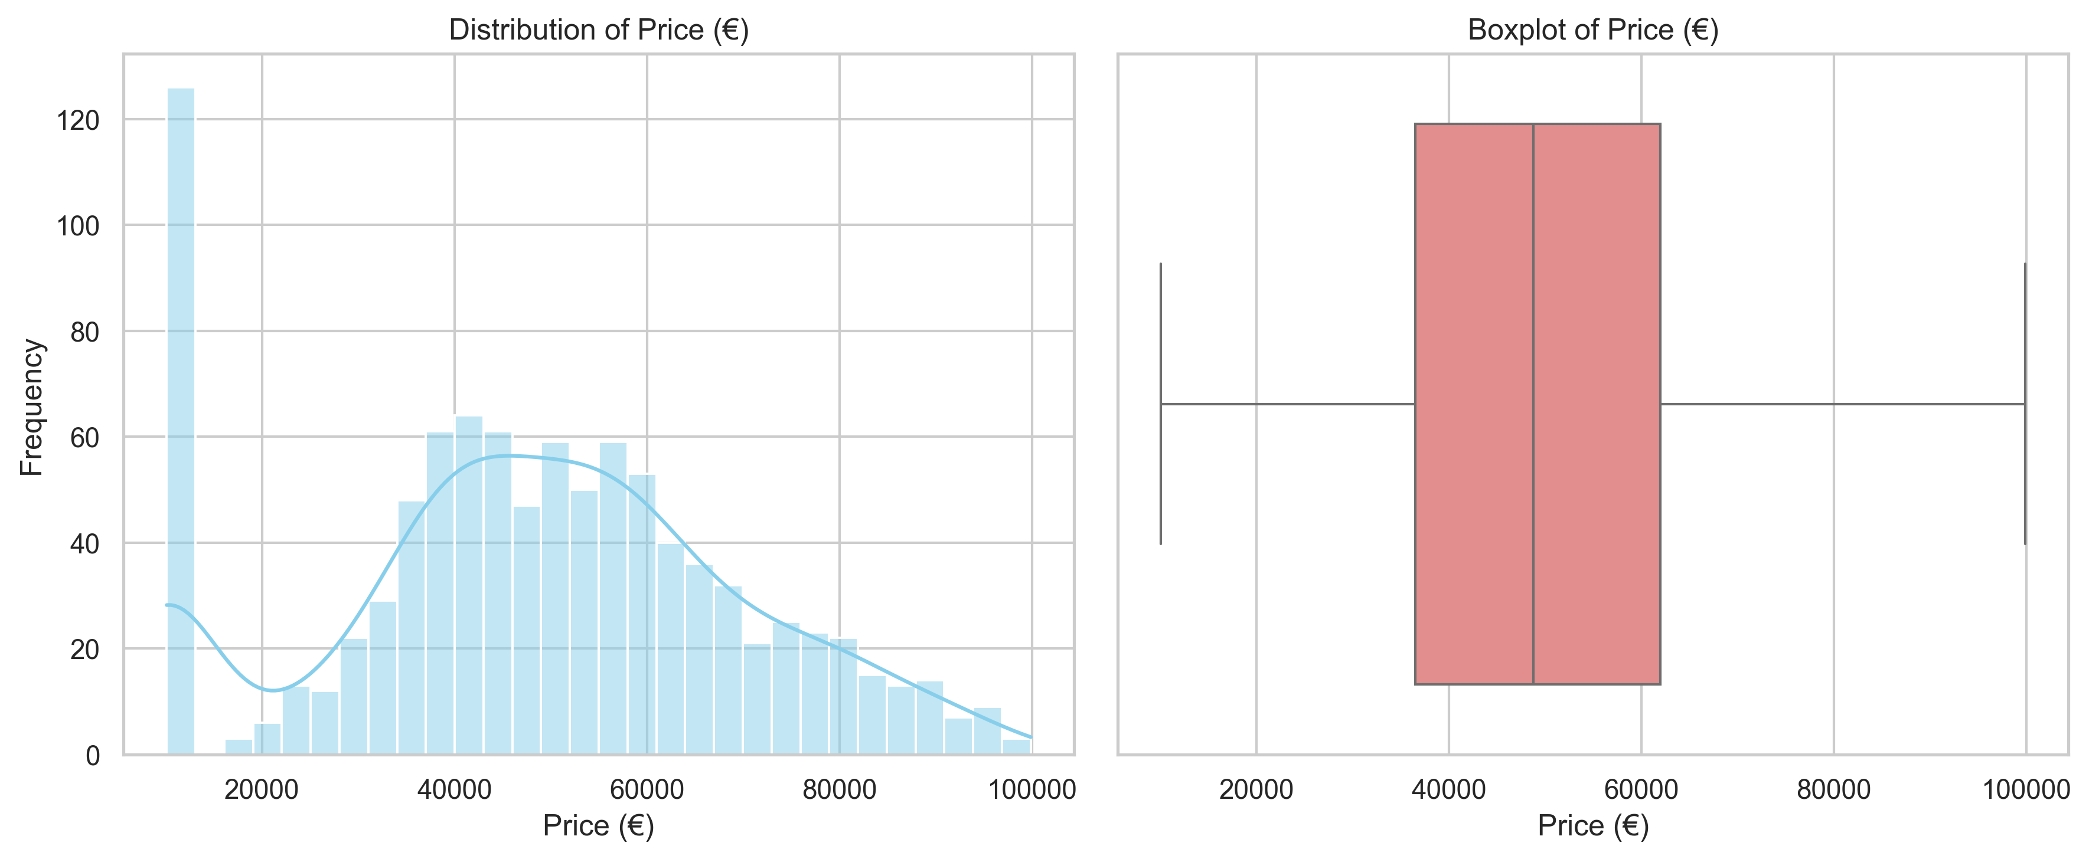
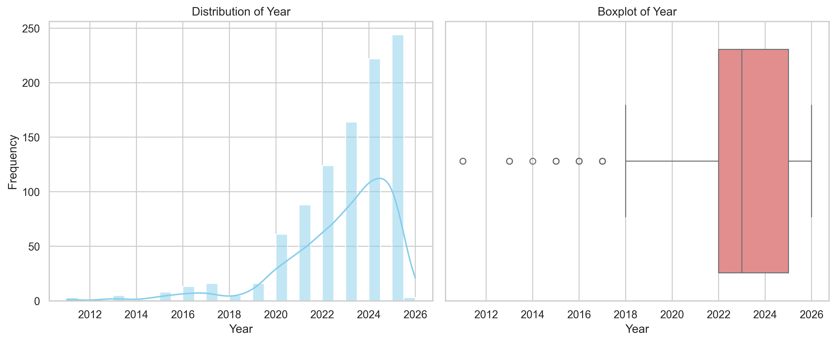
Price & Temporal Analysis
Price Range: €10,089 - €99,889 (diverse market segments)
Right-Skewed Pricing: Most EVs mid-range, fewer luxury models
Model Years: Concentrated in 2020-2024 (modern dataset)
Market Evolution: Rapid refresh cycles evident
Diverse price segmentation with accelerating model innovation

Slide 15
PART 2: BIVARIATE ANALYSIS

Slide 16
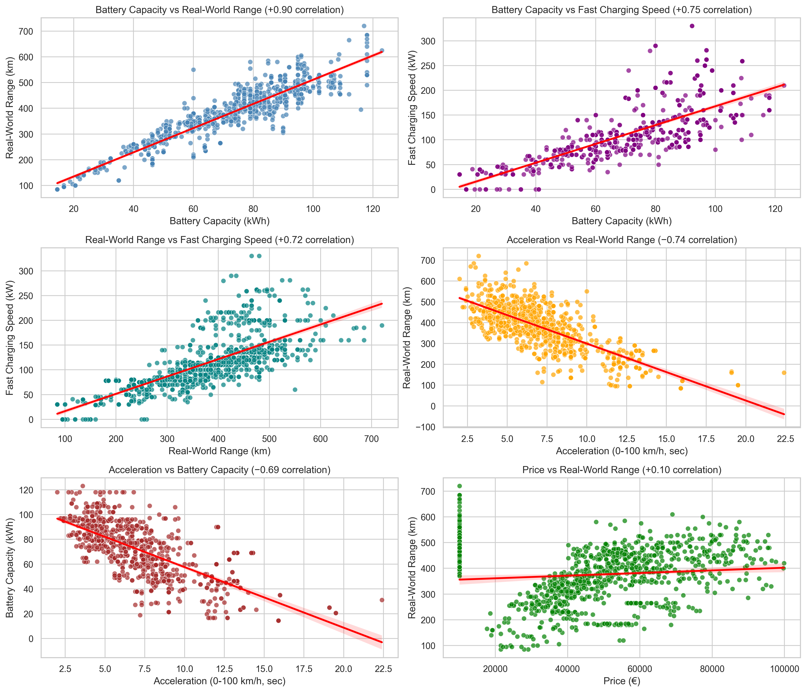
Critical Performance Relationships
Battery vs Range: Near-perfect linear relationship
Battery vs Fast Charging: Larger batteries enable faster charging
Range vs Acceleration: Clear trade-off (performance vs efficiency)
Price vs Range: Weak correlation - brand value matters more than specs
Engineering trade-offs define market positioning strategies

Slide 17
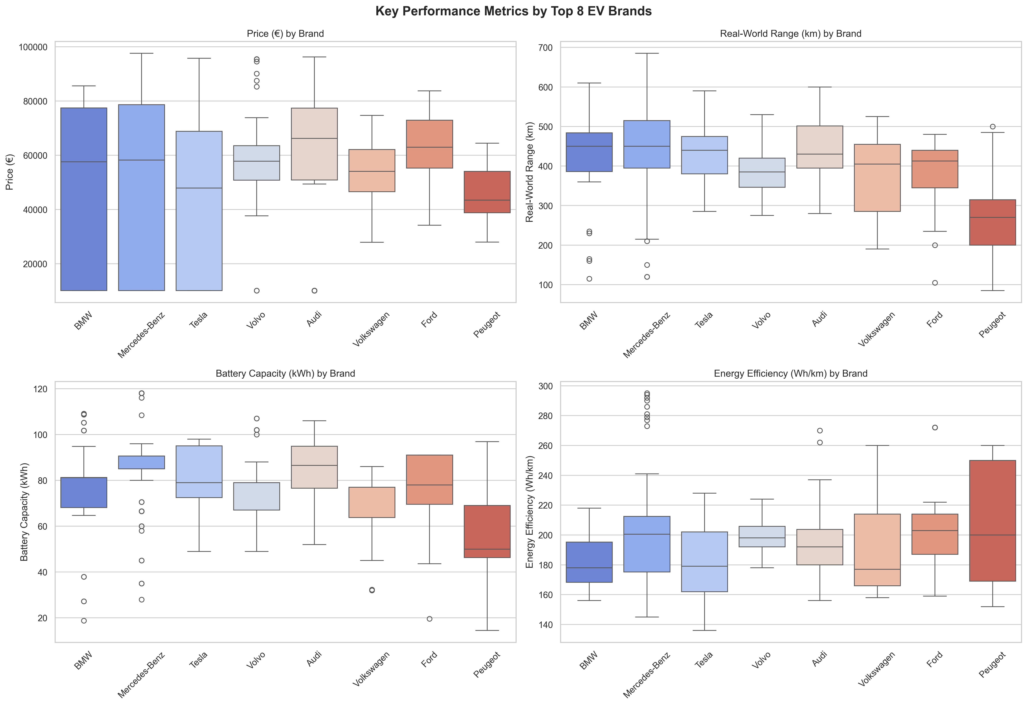
Brand Performance Positioning
Performance Leaders: Tesla (4.6s), BMW (5.5s) - fastest acceleration.
Range Champions: Audi (442km), Mercedes (439km) - maximum distance.
Efficiency Experts: BMW (182 Wh/km), Tesla (181 Wh/km) - best energy use.
Value Proposition: Tesla delivers premium performance at competitive pricing.
Clear brand specialization in performance dimensions.

Slide 18
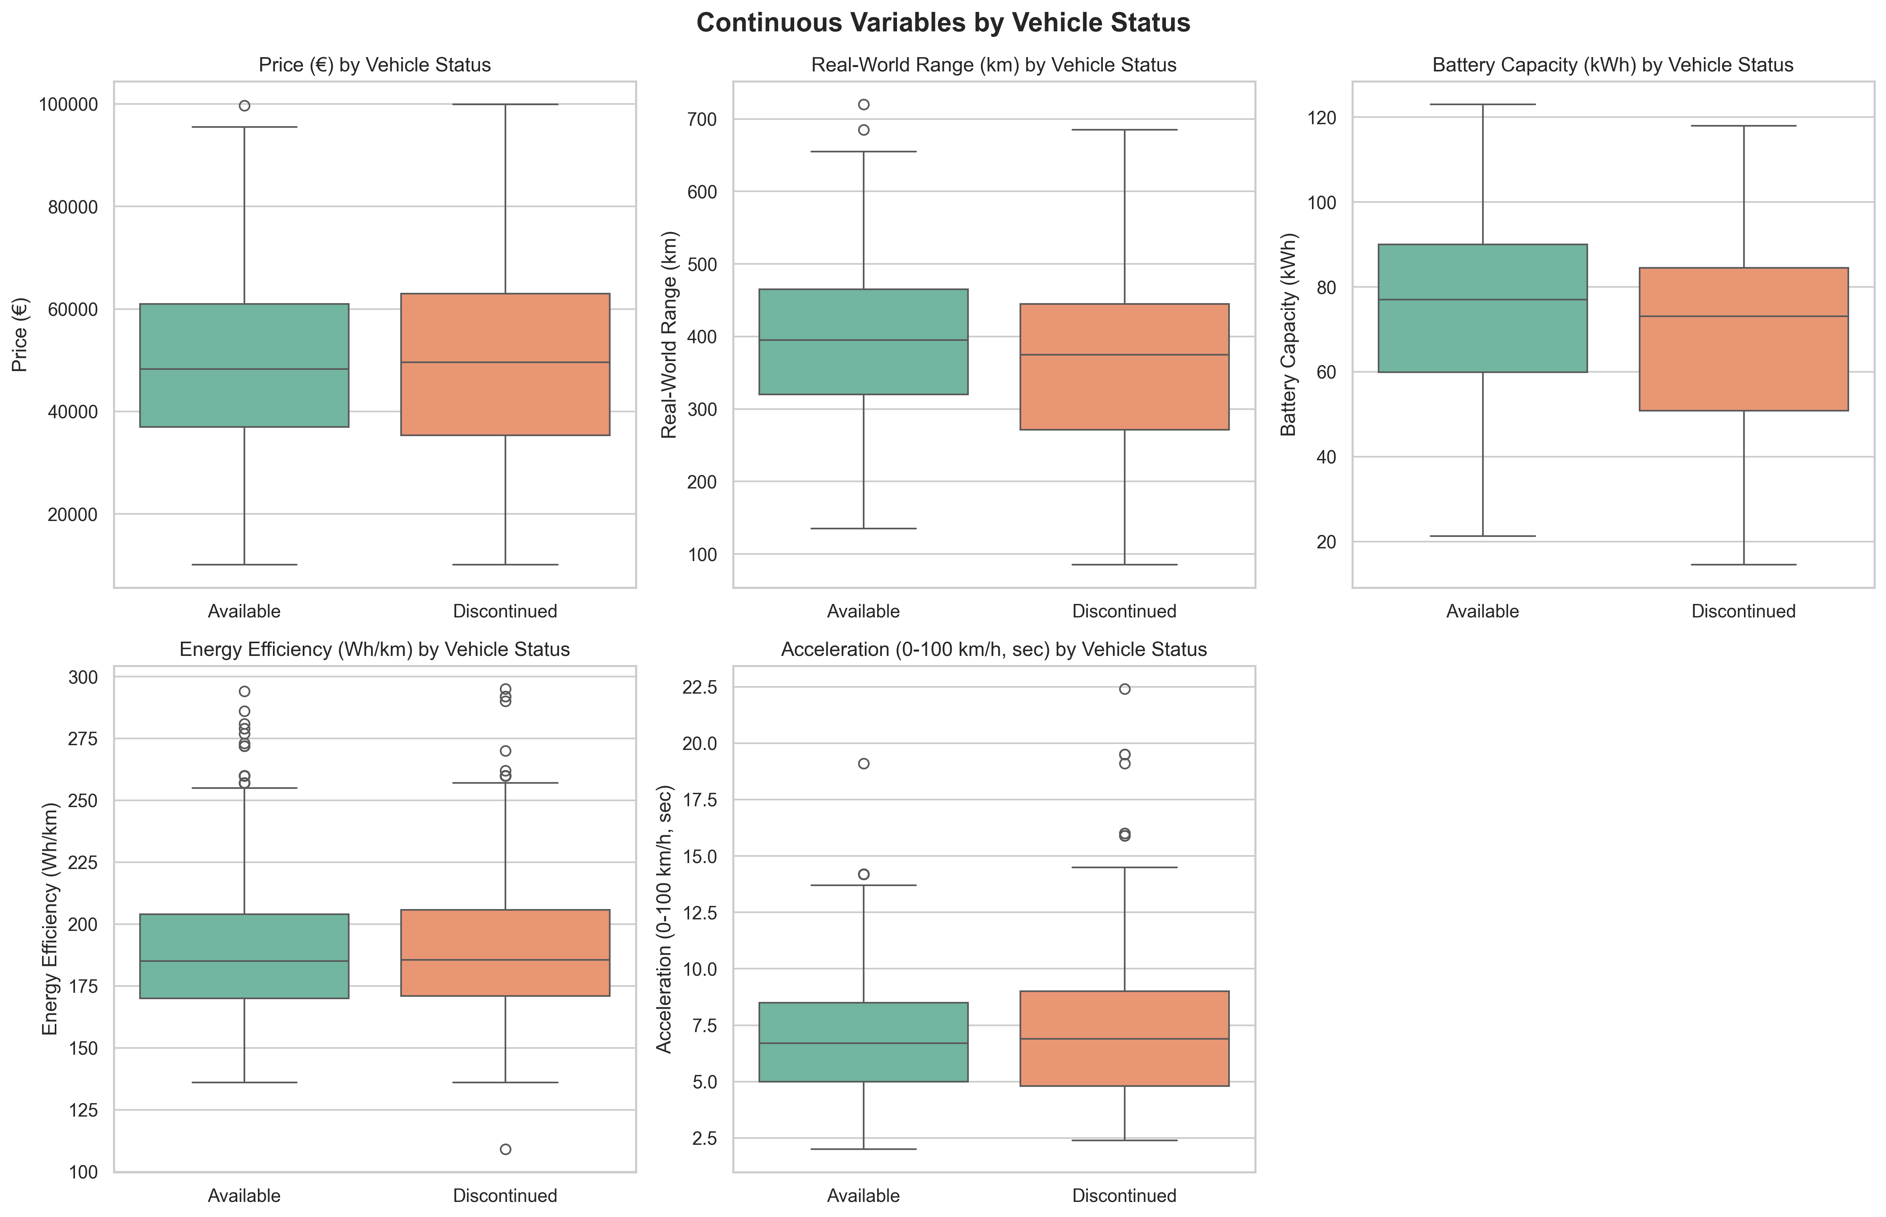
Vehicle Status Impact
Available Models: Higher battery capacity, faster acceleration
Discontinued Models: Older technology, lower performance specs
Technology Progression: Clear improvement in newer models
Market Evolution: Continuous performance upgrades
Rapid technological obsolescence driving frequent model updates

Slide 19
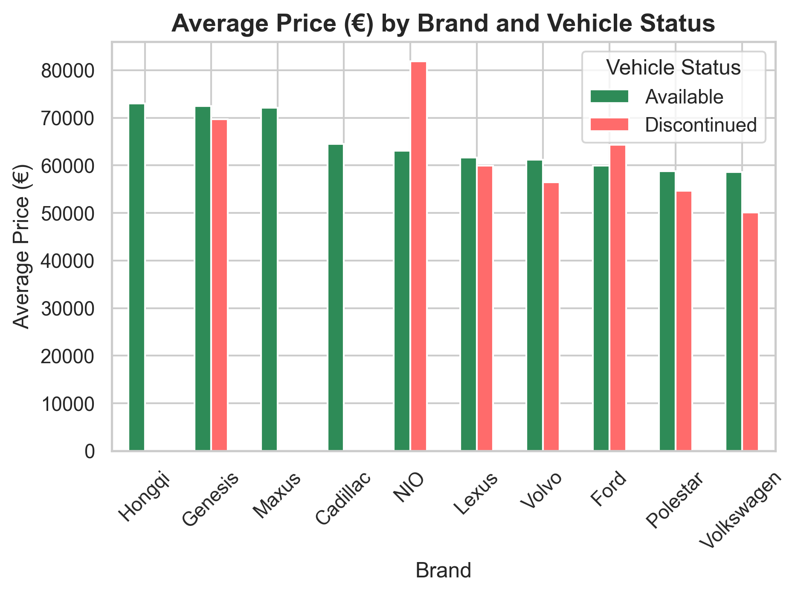
Price Analysis by Brand & Status
Premium Stability: Mercedes, Audi, Volvo maintain €50-60K pricing.
Mass Market: Volkswagen, Peugeot focus on €40-50K range.
Status Impact: Available vs discontinued shows pricing strategies.
Brand Equity: Luxury brands maintain price premiums.
Brand positioning determines pricing power more than technical specs

Slide 20
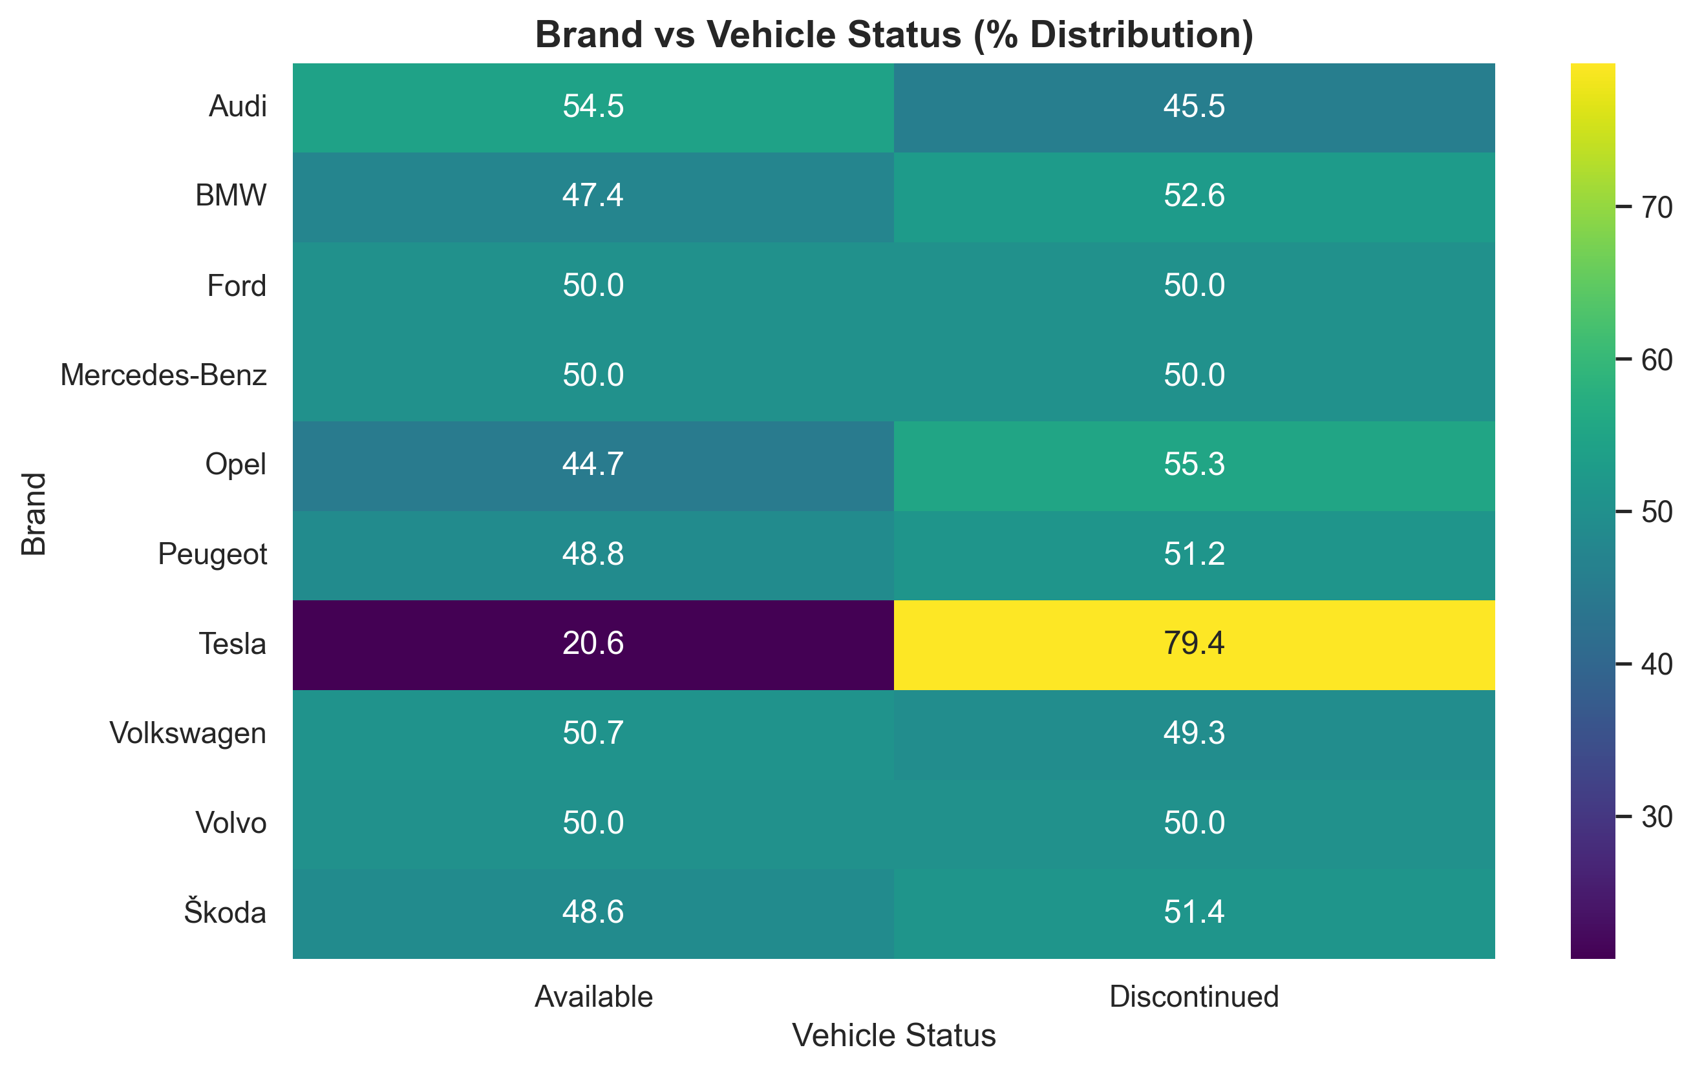
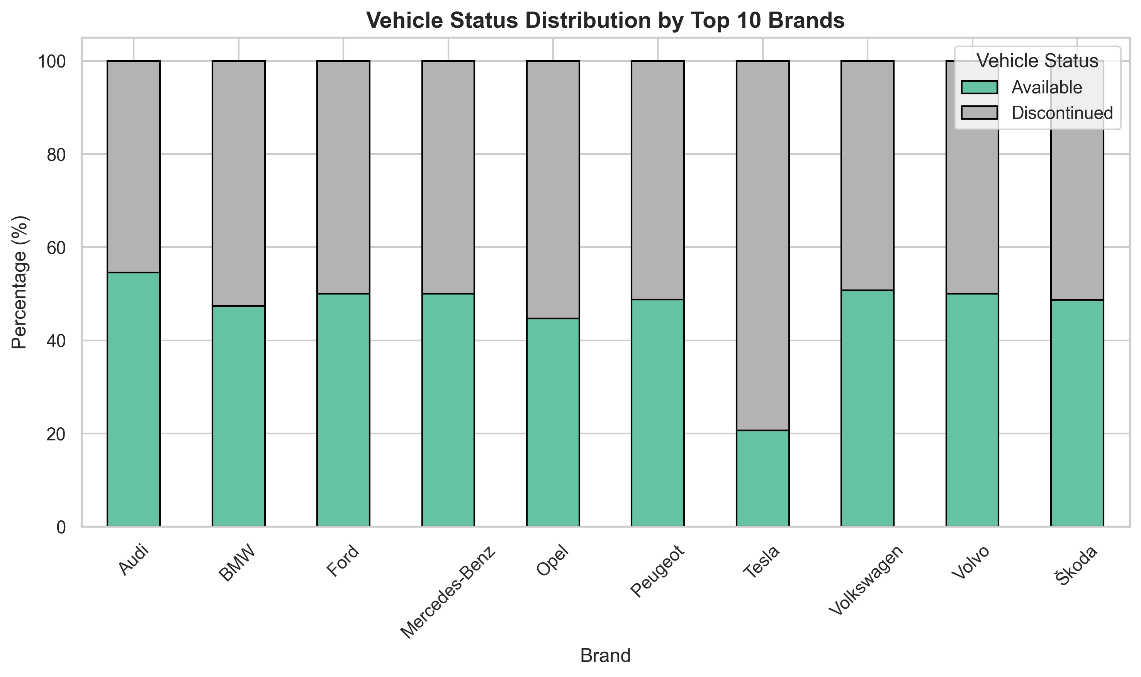
Product Lifecycle Strategies
Aggressive Innovation: Tesla (79.4% discontinued) - rapid refresh.
Balanced Approach: VW, Mercedes, Ford (50/50 split) - stable evolution.
Growth Focus: Audi (54.5% available) - expanding portfolio.
Market Adaptation: Different strategies for different brand positions.
Diverse innovation strategies reflect brand market positions.

Slide 21
PART 3: MULTIVARIATE ANALYSIS

Slide 22
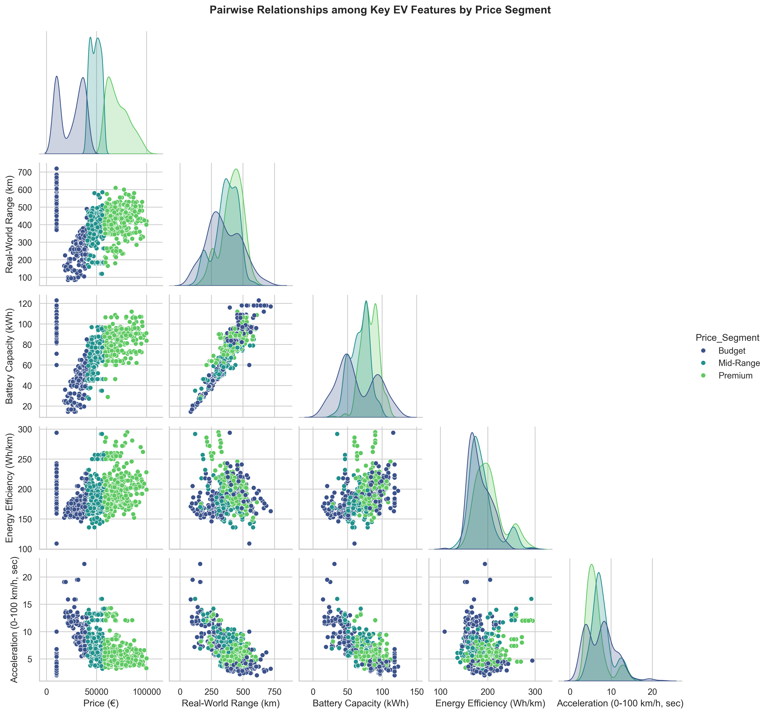
Market Segmentation Analysis
Budget Segment: Urban focus, smaller batteries, moderate range.
Mid-Range: Family vehicles, balanced performance, value pricing.
Premium: Technology leaders, maximum specs, luxury features.
Clear Clustering: Natural market segmentation emerges from data.
Three distinct market segments with different performance priorities.

Slide 23
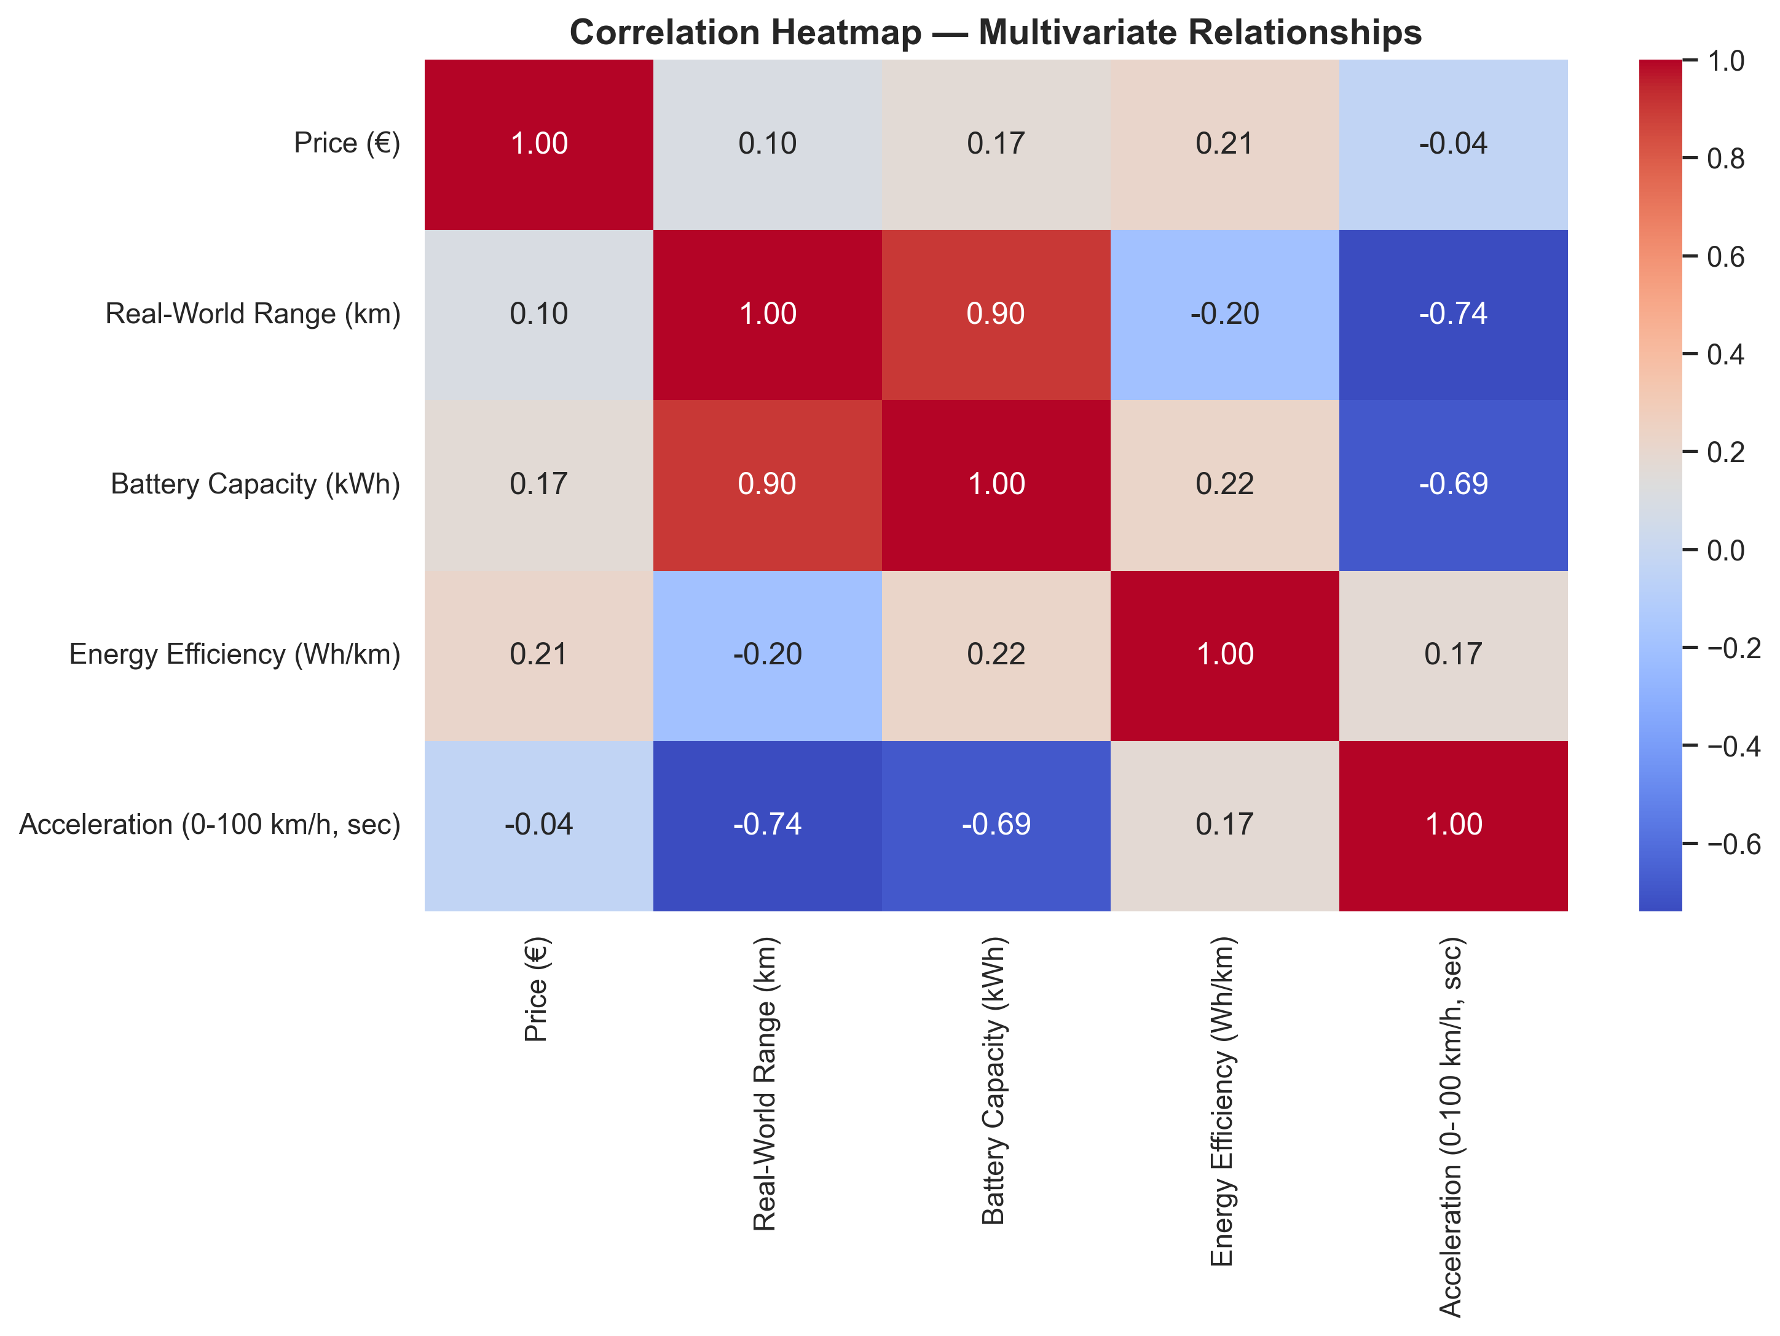
Multivariate Correlation Patterns
Strong Patterns: Battery-Range (0.90), Range-Acceleration (-0.74).
Weak Relationships: Price-Efficiency (0.21), Price-Acceleration (-0.04).
Complex Interactions: Multiple factors influence final pricing.
Brand Value: Technical specs don't fully explain pricing.
EV pricing reflects brand strategy and features beyond raw performance

Slide 24
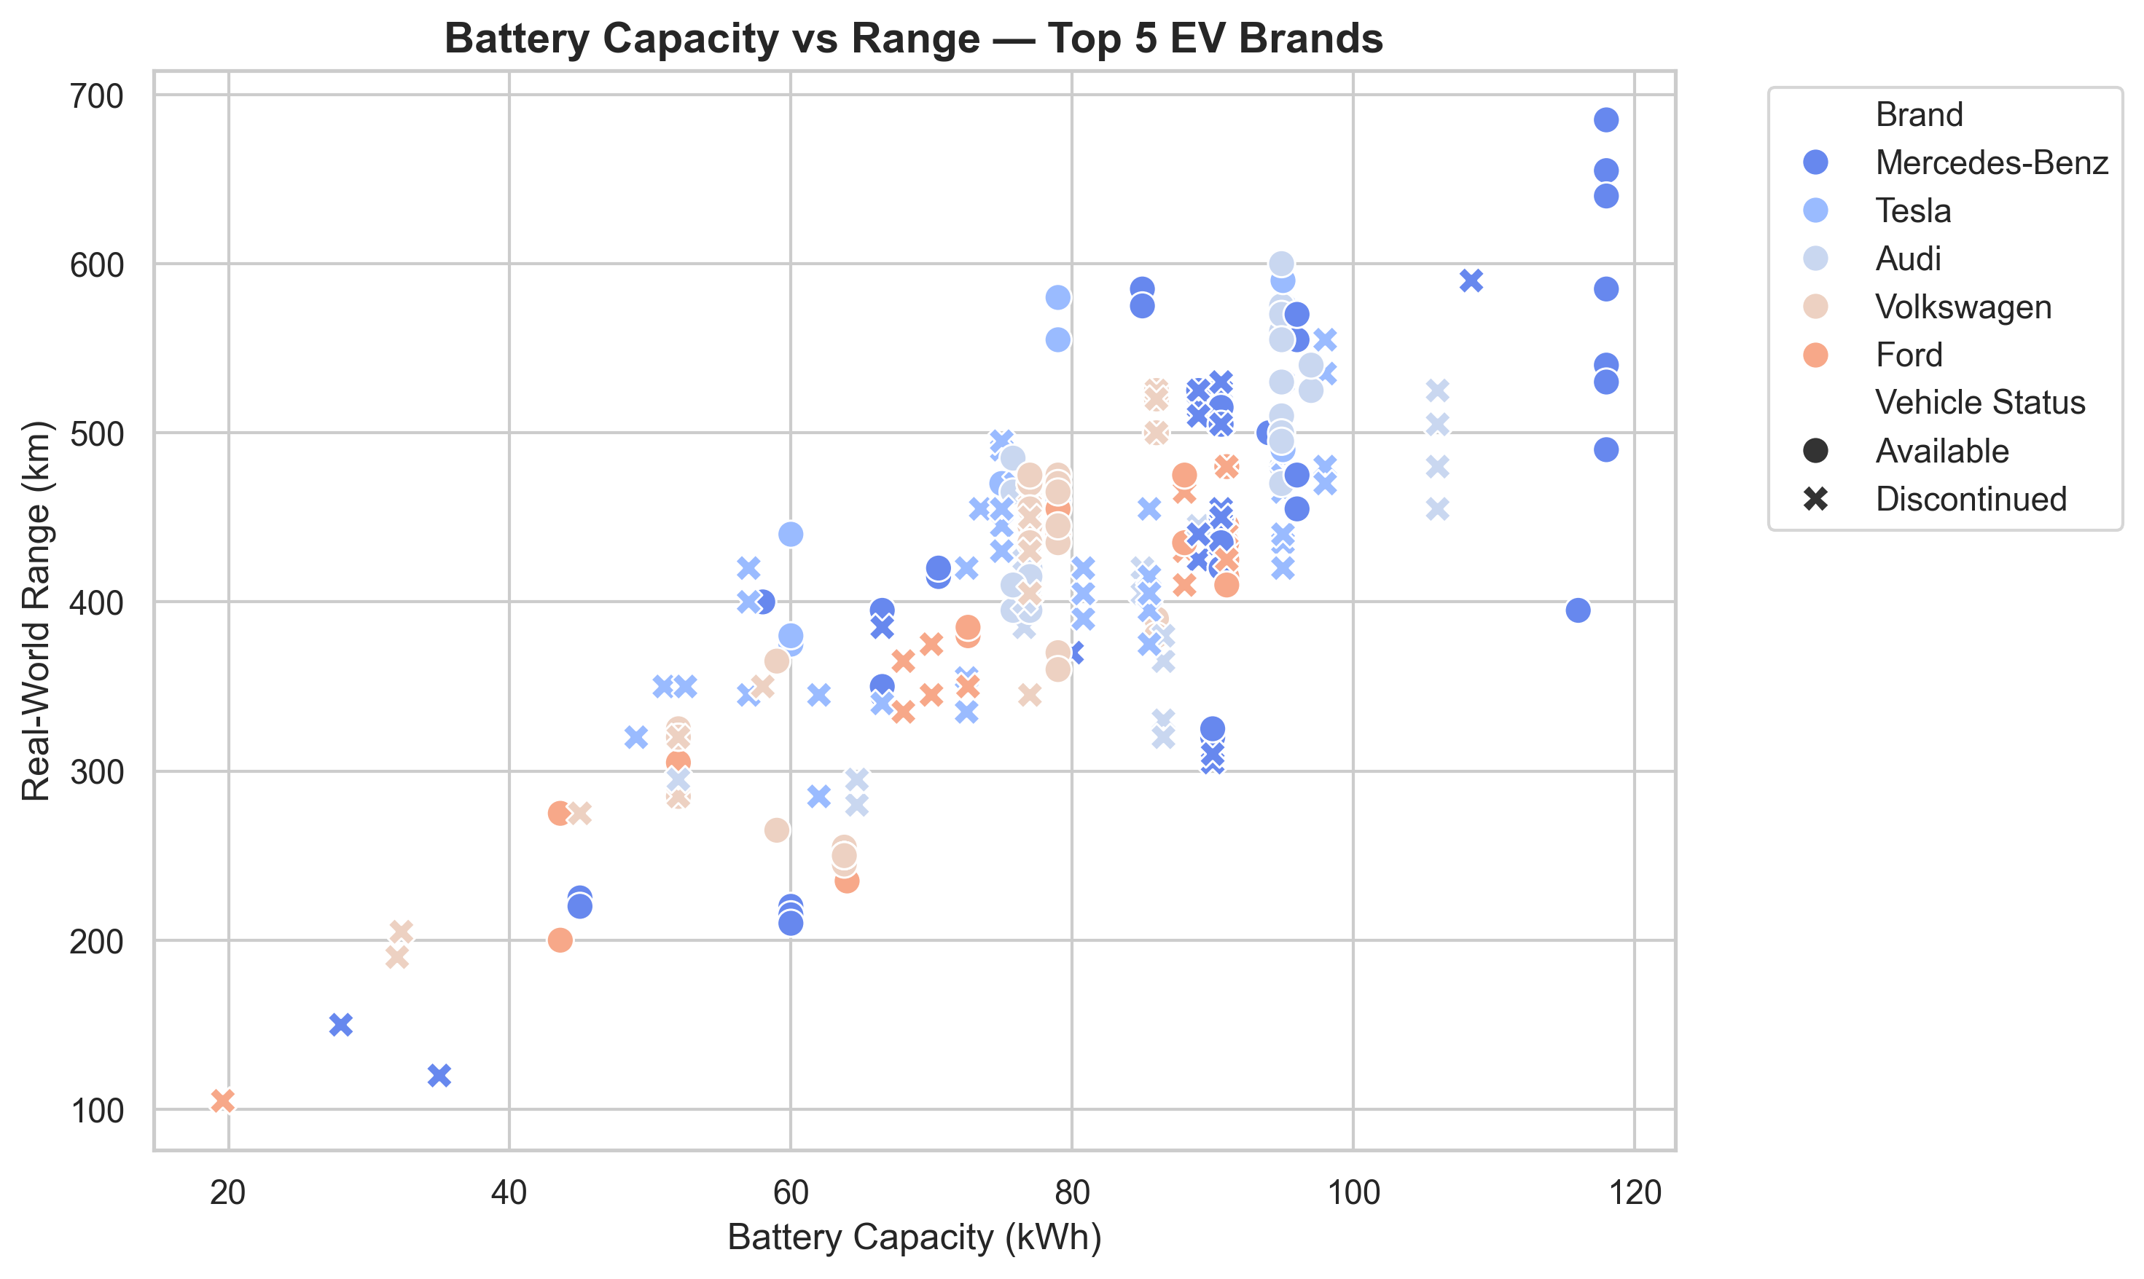
Brand-Specific Technology Strategies
Technology Leaders: Tesla, Mercedes pushing battery-range boundaries.
Efficiency Focus: BMW, Volkswagen optimizing within constraints.
Premium Positioning: Audi combining luxury with performance.
Market Coverage: Different brands targeting different segments.
Brands strategically position across the performance spectrum.

Slide 25
Key Business Insights & Recommendations
Battery capacity drives 90% of range - making it the most critical R&D focus area for competitive advantage.
Performance requires strategic trade-offs - faster acceleration (under 5s) reduces range by 25-30%, forcing clear market positioning.
Price reflects brand value more than specs - only 10% correlation with range means luxury branding often outweighs technical capabilities.
Tesla sets innovation pace - 79% model discontinuation rate demonstrates aggressive product evolution cycles.
European dominance with clear segmentation - German brands lead across Budget (under €36K), Mid-Range (€36-62K), and Premium (over €62K) segments.
Charging & efficiency standards converging - 75% battery-charging correlation and 170-210 Wh/km efficiency band show market maturation.

Slide 26
Conclusion
The EV market is steadily expanding, showing balanced competition among established automakers and emerging brands.
Rapid advancements in battery capacity, charging speed, and efficiency drive continuous model evolution.
Brands adopt varied strategies — from performance-oriented (Tesla, BMW) to efficiency-focused (Peugeot, VW) models — targeting different customer segments.
Growing focus on affordability, sustainability, and charging infrastructure will define the next phase of EV adoption worldwide.

Slide 27
Experience – Web Scraping & Data Analysis
Web Scraping: Extracted real-world EV data from online automotive sources using Python (BeautifulSoup & Requests).
Data Cleaning: Processed and standardized messy raw data — handled missing values, duplicates, and formatting issues.
Exploratory Data Analysis (EDA): Visualized trends in price, range, battery capacity, and efficiency using Pandas, Matplotlib, and Seaborn.
Insights Generation: Identified brand performance trends, price vs range correlations, and market segmentation patterns.
Practical Outcome: Built a structured, insight-rich dataset for understanding factors influencing EV market value.

Slide 28
Challenges – Web Scraping & Data Analysis
Data Inconsistency: Variations in website structures made data extraction and formatting difficult.
Missing & Noisy Data: Some EV specs were incomplete or contained non-standard units.
Data Cleaning Complexity: Handling mixed data types (numbers, text, symbols) during preprocessing.
Visualization Balance: Choosing clear visuals to summarize multi-dimensional relationships effectively.

Slide 29


